Slide 1
Computer Architecture (Fall 2021)
Lecture 10
Pipelining
Dr. Yujuan Tan (谭玉娟)
Office: Main Building 0626
Email: tanyujuan@cqu.edu.cn

Slide 2
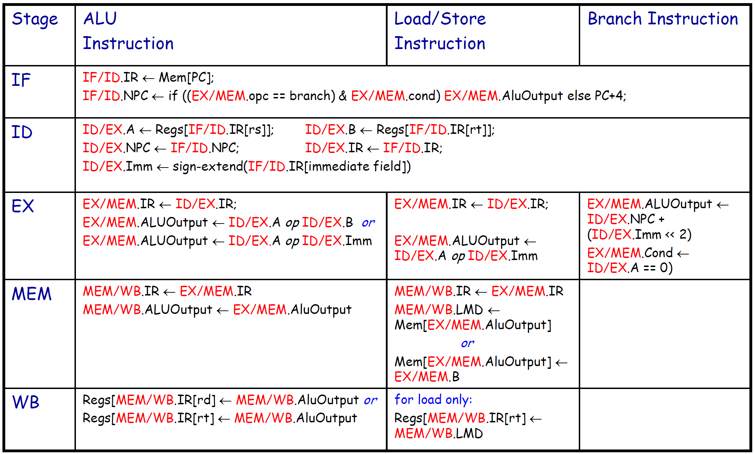
MIPS Pipeline: Events per Stage

Slide 3
MIPS Features that Simplify Pipelining
• ISA encoding: all instructions have same length
– balanced separation of fetch and decode stages
• ISA encoding: few instructions formats with the source
register fields in the same position
– symmetry allows reading of register file and decoding of instruction
simultaneously during the second stage (fixed-field decoding)
• Memory accessed only by load/store instructions
– memory address is “pre-computed” during the execution stage for
the following stage (no operation involves operands in memory)
• Each operation writes at most on result (and near the end of the pipeline)
– simplifies forwarding (useful for handling data hazards)
• All instructions change an entire register, memory access does not require realignment…
– simpler instructions can be decomposed in steps that can be
performed each in a single pipeline stage

Slide 4
Basic Pipeline
Clock number
1 2 3 4 5 6 7 8 9
Instr #
IF ID EX MEM WB
i
i +1
IF ID EX MEM WB
i +2
IF ID EX MEM WB
i +3
IF ID EX MEM WB
i +4
IF ID EX MEM WB

Slide 5
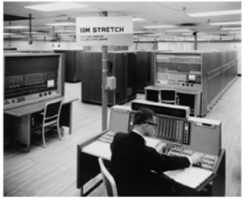
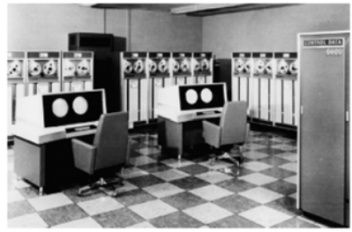
The First Pipelined Computers
• IBM 7030 “Stretch”
– considered one of the first
general-purpose pipelined computer
(late 1950s)
– pipeline overlapping fetch, decode,
execute stages
• CDC 6600
– Control Data Corp. (Seymour Cray)
– the first supercomputer (1964)
– interaction between ISA and
pipeline HW was well understood
• ISA was kept simple on purpose
• IBM 360
– more complex pipeline with
Tomasulo’s Algorithm (1964)

Slide 6

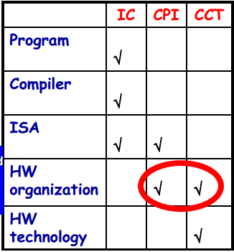

MIPS Pipelining: Basic Performance Issues
• Pipelining
– improve CPU Throughput
(reciprocal of CPU Time)
– slightly increases execution time
– result: program run faster!
• Pipelining can be seen as either
– decreasing the CPI of a multi-cycle un-pipelined implementation
– decreasing the CCT of a single-cycle un-pipelined implementation

Slide 7
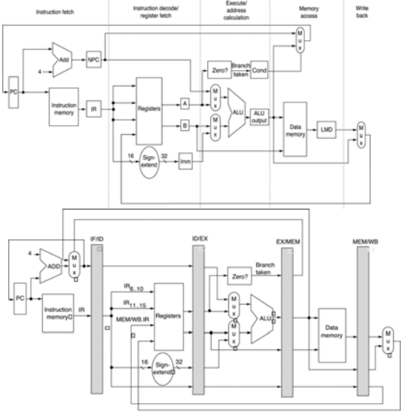
Example: Pipelining Speedup vs.
Multi-cycle Non-Pipelined Implementation
• Instruction CPI
– 4 cycles (branches and stores)
– 5 cycles (other instructions)
• Average CPI = 4.75 assuming
– 15% branches
– 10% stores
• Average Instruction ExecTime
is 4.75ns, assuming CCT = 1ns
• Ideal CPI = 1 (almost always)
• Average Instruction ExecTime
is 1.2ns with CCT = 1ns and
clock overhead = 0.2 ns
• Speedup is 3.96x for ideal
pipeline
– as we’ll see soon, in reality we
need to sum the pipeline
stalled clock cycles per

Slide 8
Performance limitations
Imbalance among pipe stages
limits cycle time to slowest stage
Pipelining overhead
Pipeline register delay
Clock skew
Clock cycle > clock skew + latch overhead
Hazards

Slide 9
Pipeline Resources
IM
Reg
DM
Reg
ALU
IM
Reg
DM
Reg
ALU
IM
Reg
DM
Reg
ALU
IM
Reg
DM
Reg
ALU
IM
Reg
DM
Reg
ALU

Slide 10
Pipeline Hazards and Their Classification
• Pipeline hazard situation
– “the next instruction cannot execute in the following clock cycle”
• Pipeline hazards come in three different flavors
– Structural Hazards
• arise from resource conflict: the HW cannot support all possible instruction combinations simultaneously in overlapped execution
– Data Hazards
• arise when an instruction depends on the result of a previous instruction in a way exposed by the pipeline overlapped execution
– Control Hazards
• arise from the pipelining of branches, jumps…
• Hazards may force pipeline stalling
– Instructions issued after the stalled one must stall also (and
fetching is stalled) while all those issued earlier must proceed

Slide 11
Structural Hazards
Overlapped execution of instructions:
Pipelining of functional units
Duplication of resources
Structural Hazard
When the pipeline can not accommodate some combination of instructions
Consequences
Stall
Increase of CPI from its ideal value (1)

Slide 12
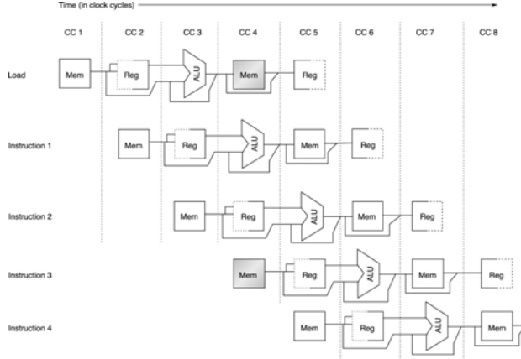
Structural Hazards: Examples
• Structural hazards
are due to resource
constraints:
– some resources are
not duplicated
enough to allow all
combination of
instructions in the
pipeline to execute
• e.g., the
architecture is
not Harvard-like
– a functional unit is
not fully pipelined
• e.g., an instruction
takes more than
one clock cycle to
go through it
The ultimate reason for the presence
of structural hazards is the designers’
attempt to reduce implementation costs

Slide 13
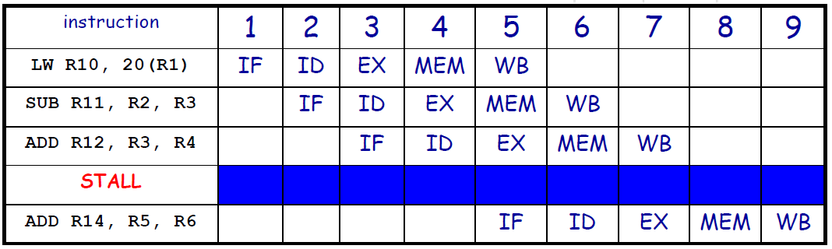
Pipeline Stalls (or Bubbles): Example of Loading/
Fetching from a Unified Single-Port Memory
• Structural
hazard causes a
bubble
– it floats
through the
pipeline taking
space but
carrying no
useful
information
A bubble always
increases the CPI of the microprocessor
implementation

Slide 14
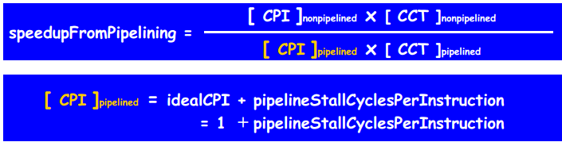

Impact of Stalls on the Performance of
Pipelined Implementation
• Special case: ignoring the pipeline clock-period overhead and assume that
– the pipeline stages are perfectly balanced
– all instructions take the same number of cycles in the non-pipelined implementation (equal to the pipeline depth)

Slide 15
Impact of Stalls on the Performance of
Pipelined Implementation - Example
• Implementation without structural hazards
– ideal CPI = 1
– CCT = 1ns
• Implementation with the “load/store” structural hazard
– CCT = 900ps
• Suppose that
– 40% of the executed instructions are loads or stores
• Which implementation is faster?
– (averageInstructionTime)_noHaz = 1 * 1 = 1
– (averageInstructionTime)_haz = (1 + 0.4 * 1) * 0.9 = 1.26
– implementation without structural hazard is 1.26 times faster than the other

Slide 16
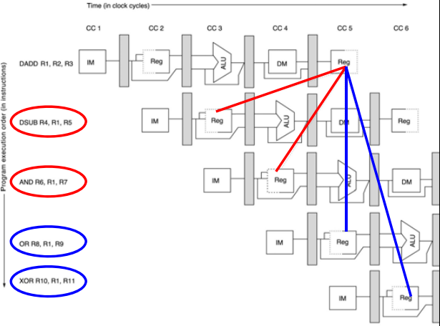
Data Hazards
• Which value do
these
instructions read
from R1 ?
– Unless we take
care of the
data hazard
the value read
is not even
deterministic!
• This data hazard
is called RAW
(read after
write)
– the name
refers to the
expected
execution flow

Slide 17
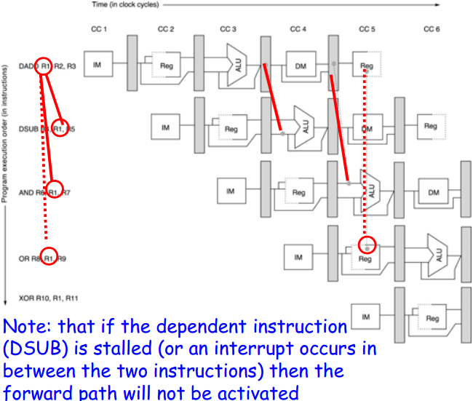
Minimizing Data Hazards:Forwarding (or By-Passing)
• An efficient
technique based
on a simple idea
– subsequent
instructions only
need the value in
R1 after this has
been computed!
• ALU result is
always fed back to
the ALU input
from both
EX/MEM and
MEM/WB

Slide 18
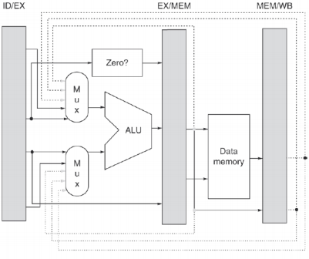
Forwarding to the ALU
• 3 inputs added to the MUX
• 3 bypass paths
1. From ALU output at the end of EX
2. From ALU output at the end of MEM stage
3. The memory output at the end of the MEM stage

Slide 19
Data Dependences
Types of data dependences
Flow dependence (true data dependence – read after write)
Output dependence (write after write)
Anti dependence (write after read)
Which ones cause stalls in a pipelined machine?
For all of them, we need to ensure semantics of the program are correct
Flow dependences always need to be obeyed because they constitute true dependence on a value
Anti and output dependences exist due to limited number of architectural registers
They are dependence on a name, not a value
We will later see what we can do about them

Slide 20
How to Handle Data Dependences
Anti and output dependences are easier to handle
write to the destination in one stage and in program order
Flow dependences are more interesting
Five fundamental ways of handling flow dependences
Detect and wait until value is available in register file
Detect and forward/bypass data to dependent instruction
Detect and eliminate the dependence at the software level
No need for the hardware to detect dependence
Predict the needed value(s), execute “speculatively”, and verify
Do something else (fine-grained multithreading)
No need to detect

Slide 21
Data Dependence Types
Flow dependence
r₃ ← r₁ op r₂ Read-after-Write
r₅ ← r₃ op r₄ (RAW)
Anti dependence
r₃ ← r₁ op r₂ Write-after-Read
r₁ ← r₄ op r₅ (WAR)
Output-dependence
r₃ ← r₁ op r₂ Write-after-Write
r₅ ← r₃ op r₄ (WAW)
r₃ ← r₆ op r₇

Slide 22
Review: An example with dependencies
sub $2, $1, $3
and $12, $2, $5
or $13, $6, $2
add $14, $2, $2
sw $15, 100($2)
There are several dependencies in this new code fragment.
The first instruction, SUB, stores a value into $2.
That register is used as a source in the rest of the instructions.
This is not a problem for the single-cycle and multicycle datapaths.
Each instruction is executed completely before the next one begins.
This ensures that instructions 2 through 5 above use the new value of $2 (the sub result), just as we expect.
How would this code sequence fare in our pipelined datapath?

Slide 23
Data hazards in the pipeline diagram
 | Clock cycle
 | 1 | 2 | 3 | 4 | 5 | 6 | 7 | 8 | 9
sub $2, $1, $3 | IF | ID | EX | MEM | WB
and $12, $2, $5 |  | IF | ID | EX | MEM | WB
or $13, $6, $2 |  |  | IF | ID | EX | MEM | WB
add $14, $2, $2 |  |  |  | IF | ID | EX | MEM | WB
sw $15, 100($2) |  |  |  |  | IF | ID | EX | MEM | WB
The SUB instruction does not write to register $2 until clock cycle 5. This causes two data hazards in our current pipelined datapath.
The AND reads register $2 in cycle 3. Since SUB hasn’t modified the register yet, this will be the old value of $2, not the new one.
Similarly, the OR instruction uses register $2 in cycle 4, again before it’s actually updated by SUB.

Slide 24
What about loads?
Imagine if the first instruction in the example was LW instead of SUB.
How does this change the data hazard?
Clock cycle
1 2 3 4 5 6
lw $2, 20($3)
and $12, $2, $5
IM
Reg
DM
Reg
IM
Reg
DM
Reg

Slide 25
What about loads?
Imagine if the first instruction in the example was LW instead of SUB.
The load data doesn’t come from memory until the end of cycle 4.
But the AND needs that value at the beginning of the same cycle!
This is a “true” data hazard—the data is not available when we need it.
Clock cycle
1 2 3 4 5 6
lw $2, 20($3)
and $12, $2, $5
IM
Reg
DM
Reg
IM
Reg
DM
Reg

Slide 26

Stalling
The easiest solution is to stall the pipeline.
We could delay the AND instruction by introducing a one-cycle delay into the pipeline, sometimes called a bubble.
Notice that we’re still using forwarding in cycle 5, to get data from the MEM/WB pipeline register to the ALU.
Clock cycle
1 2 3 4 5 6 7
lw $2, 20($3)
and $12, $2, $5
IM
Reg
DM
Reg
IM
Reg
DM
Reg

Slide 27
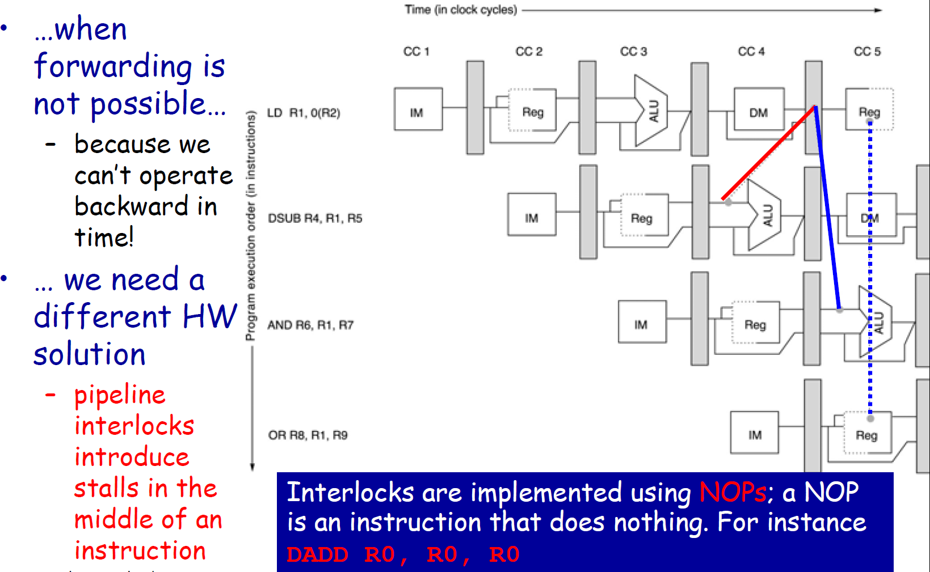
Dealing with Data Hazards: Pipeline Interlocks

Slide 28
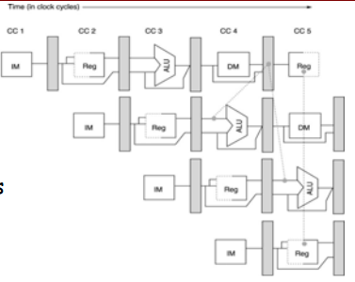
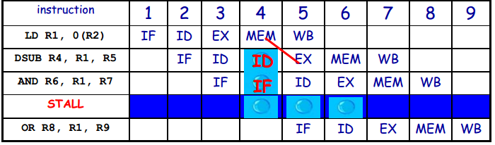
Pipeline Stalls due to Interlocks
At Cycle 4 the
progression of DSUB
(and all the following
instructions) is
halted
– no new instruction
is fetched
– a NOP instruction is
inserted into the
EX stage and will
exit the pipe at
Cycle 6
A NOP Instruction (a
bubble) that is
generated by one
interlock activation
increases the CPI of
the stalled instruction
by the length of one
clock cycle

Slide 29
Branches
Most of the work for a branch computation is done in the EX stage.
The branch target address is computed.
The source registers are compared by the ALU, and the Zero flag is set or cleared accordingly.
Thus, the branch decision cannot be made until the end of the EX stage.
But we need to know which instruction to fetch next, in order to keep the pipeline running!
This leads to what’s called a control hazard.
Clock cycle
1 2 3 4 5 6 7 8
IM
Reg
DM
Reg
beq $2, $3, Label
IM

Slide 30
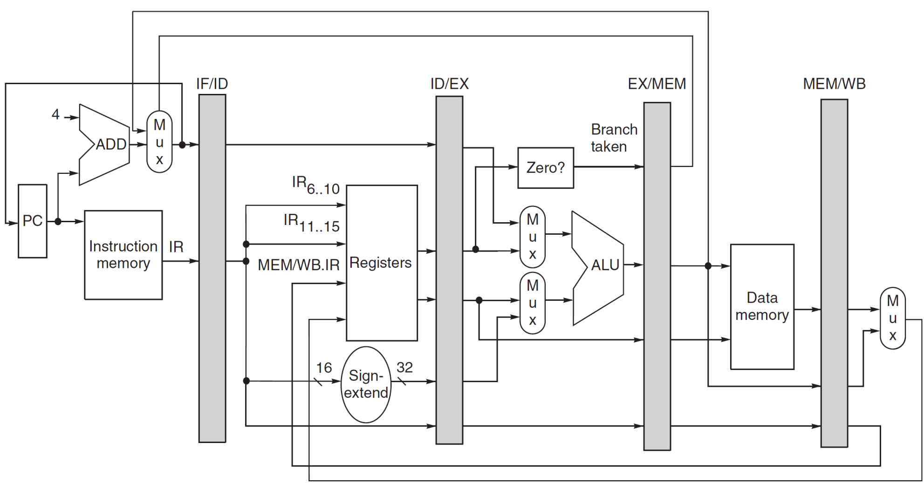
MIPS Pipeline Implementation
3 clock stall
with branch

Slide 31
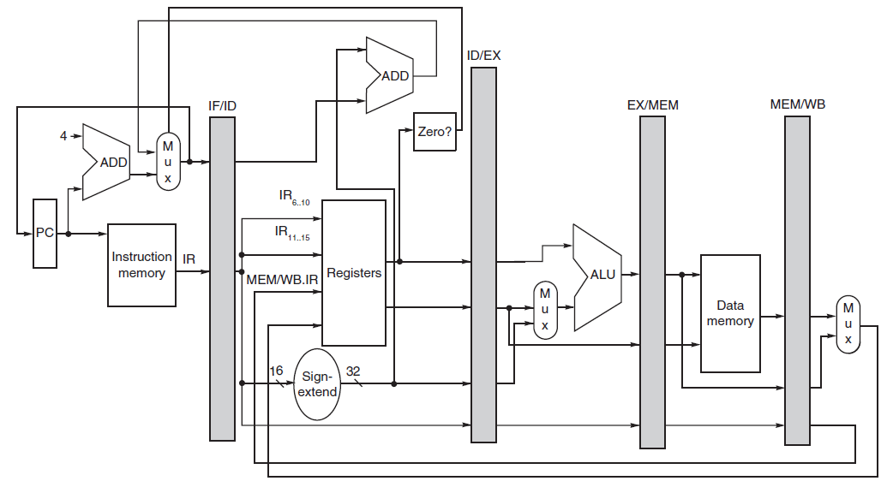
MIPS Pipeline Implementation (revised)
1 clock stall
with branch
Solved in ID

Slide 32
Branch (Control) Hazards and Their
Impact on the Pipeline Performance
Control hazards can cause a greater performance loss for a pipelined implementation than data hazards. In first approximation:
– performance loss can vary between 10% and 30%
depending on the branch frequency
– generally, the deeper the pipeline, the worse the branch penalty
(measured in clock cycles)
• Various strategies to reduce the branch penalty
– static (compile time) schemes
• they are fixed for each branch during the entire execution
– dynamic
• hardware and software techniques
• more sophisticated branch prediction schemes

Slide 33
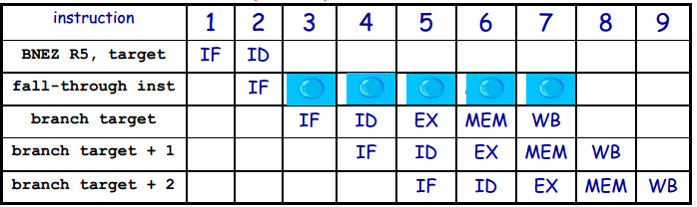
Reducing Pipeline Branch Penalties - I:
Freezing (Flushing) the Pipeline
• Assuming now that the target address calculation
and the comparison are performed during the ID
stage, then, in case of “branch taken”, the PC is
changed at the end of the ID stage
– simplest strategy: freezing the pipeline as soon as the
instruction is detected as a branch and regardless of its
outcome (branch penalty is fixed, SW cannot reduce it)

Slide 34
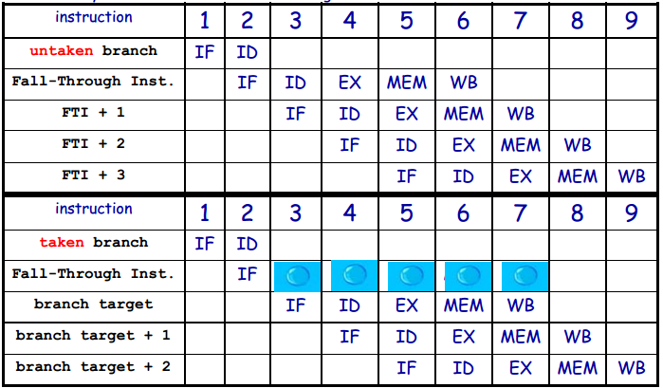
Reducing Pipeline Branch Penalties - II:
Predicting “Non-Taken”
If the branch is taken, all the fetched instruction must be turned into NOPs and it is necessary to restart the fetch at the target address. The state must be unaffected!!

Slide 35
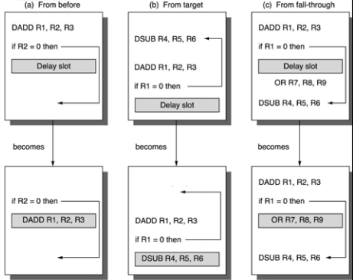
Reducing Pipeline Branch Penalties – III: Branch Delaying
The instruction in
the delay slot is
executed whether
or not the branch is
taken
Scheduling problem
for the compiler
Three strategies to
fill the delay slot
a) always best choice if
possible
b) preferred when
branch is taken with
high probability
– e.g., loop branches
c) dual case as (b)
Strategies (b) and (c) can be applied only if it is ok to execute the moved instruction if the prediction is wrong (i.e. the processor state is not affected)

Slide 36
Summary
Three kinds of hazards conspire to make pipelining difficult.
Structural hazards result from not having enough hardware available to execute multiple instructions simultaneously.
These are avoided by adding more functional units (e.g., more adders or memories) or by redesigning the pipeline stages.
Data hazards can occur when instructions need to access registers that haven’t been updated yet.
Hazards from R-type instructions can be avoided with forwarding.
Loads can result in a “true” hazard, which must stall the pipeline.
Control hazards arise when the CPU cannot determine which instruction to fetch next.
We can minimize delays by doing branch tests earlier in the pipeline.
We can also take a chance and predict the branch direction, to make the most of a bad situation.

